Slide 1
Interstellar Travel Space
Here is where your presentation begins

Slide 2
TABLE OF CONTENTS
01
02
05
Project Recap
Problem
Summary
03
The Team
We will talk about recap of this project and the data that we used it
What it’s the problem ?
Qiuck summary
04
Insights
The amazing team who work in this project
What we discovered of insight to show it to you

Slide 3
01
PROJECT RECAP
You can enter a subtitle here if you need it

Slide 4
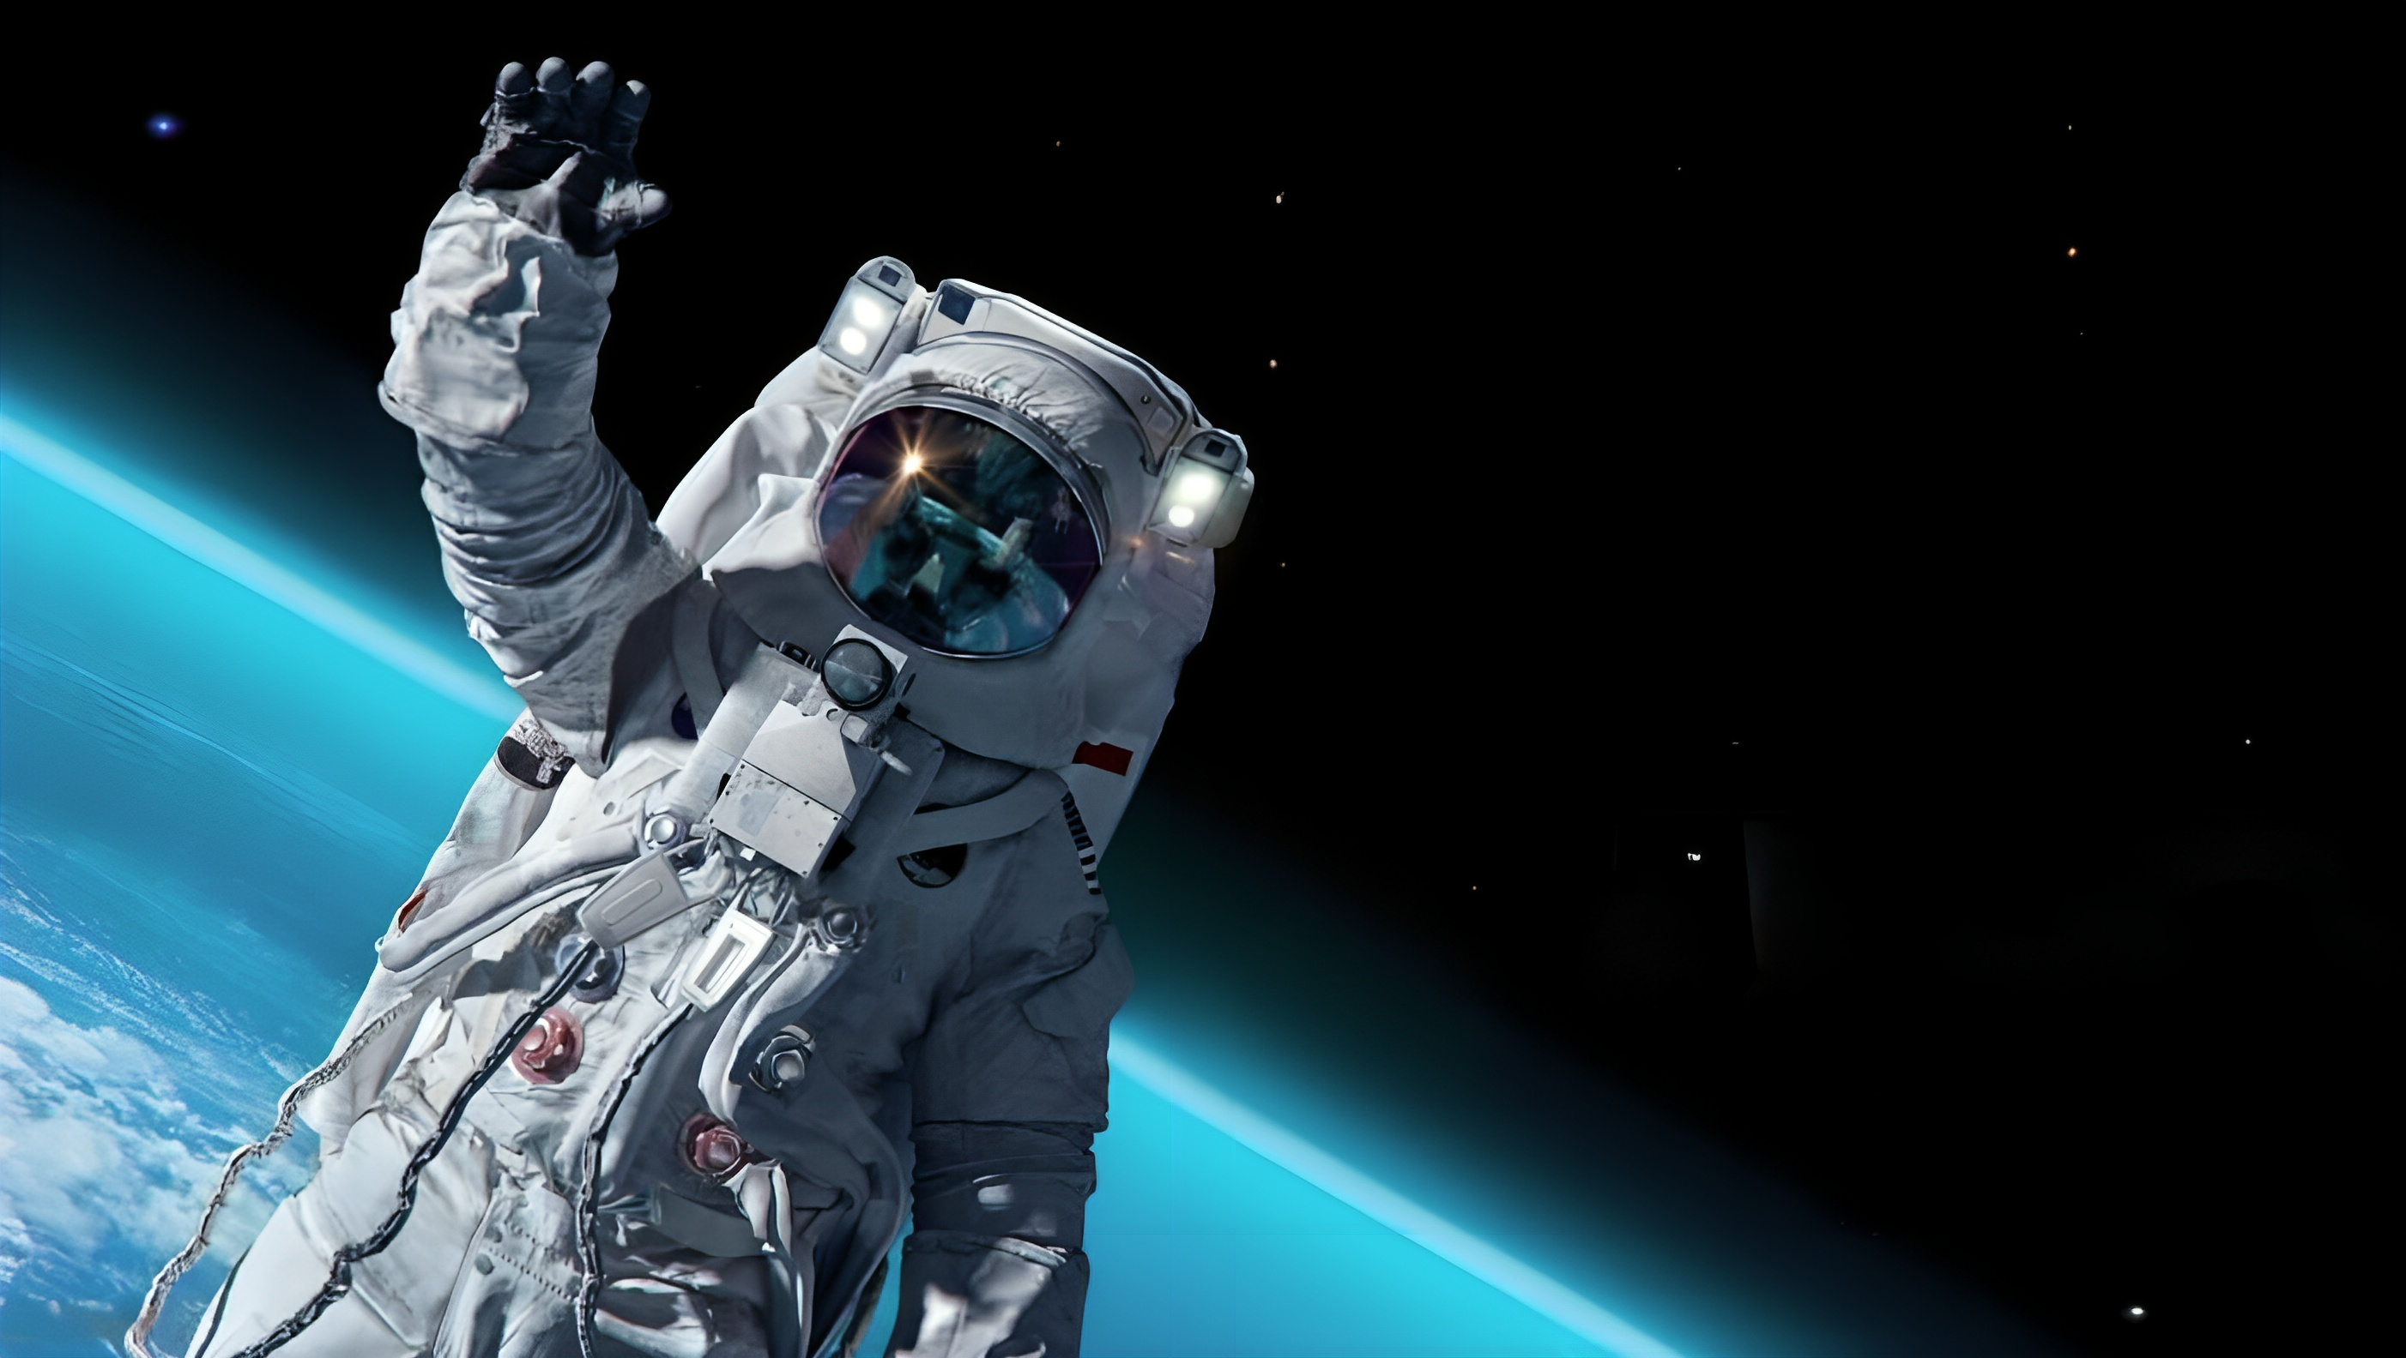
Interstellae Travel Space
In 2001, the first tourist space trip was for businessman Dennis Tito, and it cost him 20 million dollars. After the time and progress we have seen in the field of space and the spread of space companies, it has become easy for anyone to visit space at a price starting from 250,000. In this project, we apply medicine to these trips to know to what extent. So we're going to take you on a journey through this data. Please fasten your seat belt and let's go

Slide 5
02
Problem
What is the Problem?

Slide 6
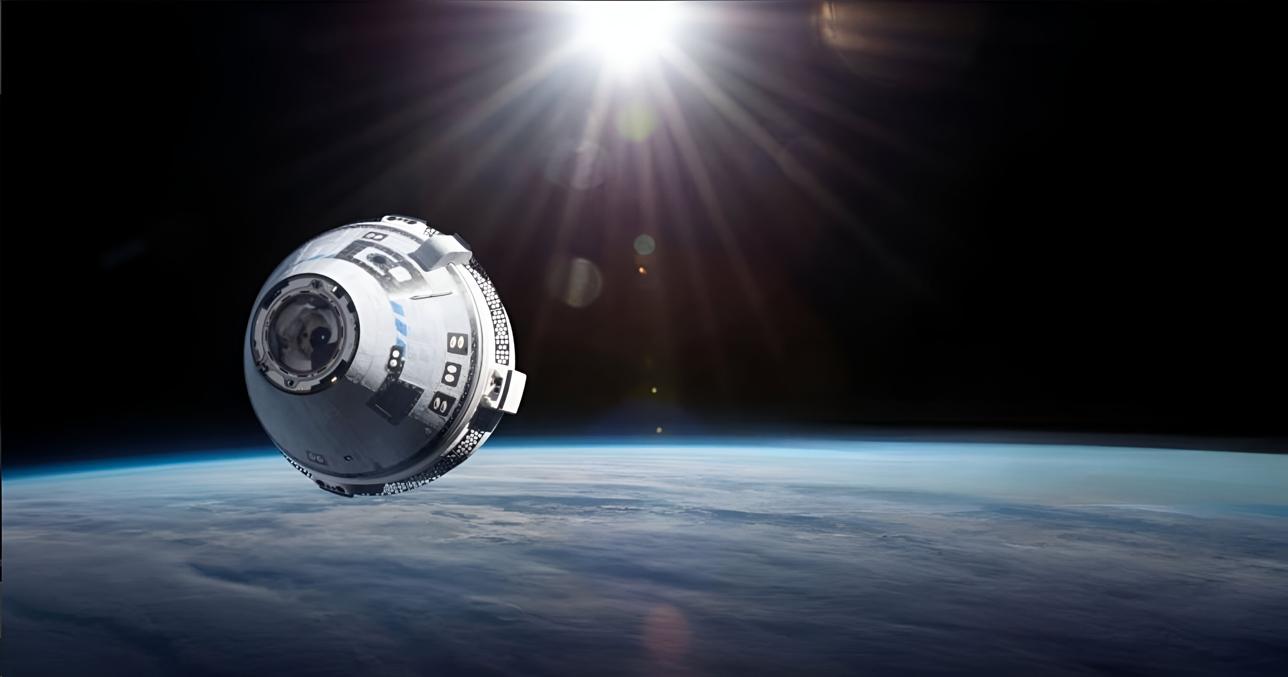
What Is The Problem?
Here we try to analyze and get to know more than 500,000 travelers. We try to find relationships from the data to discover new information that will help us understand what is happening in front of us, know our performance, and delve into learning more about this data and provide the largest amount of useful information.

Slide 7
03
The Team
What is the Problem?

Slide 8



The Analytiscs Team
Mark Jackson
Jacklin Taylor
Jinffer Joney

Slide 9
04
The Inghts

Slide 10
Age
In the list of ages, it is clear that the highest age group that makes reservations for space flights is the twenties, followed by the thirties, and finally the tenies and forties. This shows us the interest of young people in going into space and creating a new and unique adventure

Slide 11
Gender
Most reservations in space are from men, but this does not mean that the percentage of women is small. The difference is not large, about 17%. This gives us that there is interest in space travel and it is not limited to a specific gender.

Slide 12
Occupations
In occupation, we see that the percentages are close between professions. This gives us that there is interest in space travel, whatever your job, because 20 years ago it was limited to businessmen and not even any businessman, and this is due to the high prices of these trips, but now we can say that it is easy to travel to space and this is what will be explained more in Next slide

Slide 13
Travel class
In travel class, as shown, economy class is the most popular travel class. This means that it reflects the marital status of the passengers, and this means that space travel has become easier and is not limited to only a certain group.

Slide 14
Travel class
It is important to know the reason for travel. This will help us provide better space travel services

Slide 15
Booking Date
In 2023, we discovered an increase of 7% compared to the previous year. This is an amazing increase, and this confirms to us the rate of increase in interest in space travel

Slide 16
Booking Date Price
Now let's talk about the numbers in 2022. The total price of reservations was 158,267,172 million, and in 2023, reservations increased by 7%, meaning profits worth 374,571,398 million, meaning there is an increase of 216,304,226 million

Slide 17
Booking Date Price
In the special requests of customers, we wanted to know whether there is a special request that customers prefer to request, but we found that there is no special request that customers prefer over another request, and therefore we must be careful to pay attention to providing these services at the best level.

Slide 18
Customer Satisfaction Score
The loyalty program member is a program for distinguished and frequent travelers. The goal of the program is to retain frequent travelers and attract new travelers.
We see that there are 52% of travelers in the loyalty program and 42% are not in the loyalty program
This means that there is growth and prosperity in this field

Slide 19
Customer Satisfaction Score
The assessment of customer satisfaction starts from 32 to 116, so I decided to divide it into categories so that it is easy to measure
The first category is the poor, which ranges from 32 to 50
The second category is average, starting from 50 to 75
The third category is high, which starts from 75 to 115

Slide 20
05
Summary
Quick Summary

Slide 21
Summary
With more than 500,000 passengers on a journey into space, we have analyzed these passengers so that we can deal with them
An increase in passengers by 7% in the year 2023 compared to the year 2022, and an increase of 216,304,226 million dollars, and an increase is expected in 2024.
We cleaned and analyzed the data to extract the largest amount of information so that we could benefit from it and evaluate our performance
Passenger satisfaction score of 97%
In the next 10 years, promoting spaceflight will be easier than it is now
The majority of travelers are men

